Slide 1
Illuminant Estimation for Object Recognition
Sheng Hong Wang
Volume 27, Number 4, August 2002 IEEE

Slide 2
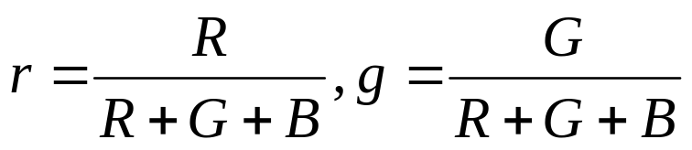
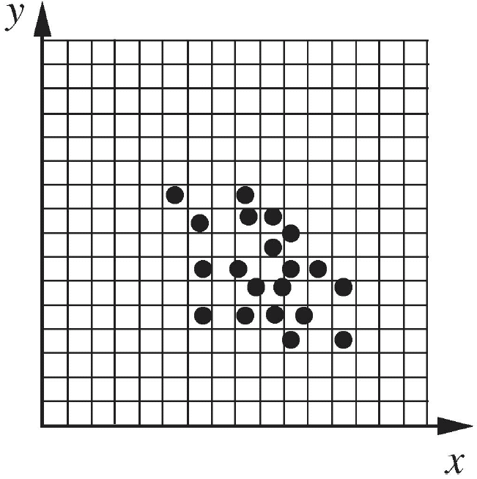
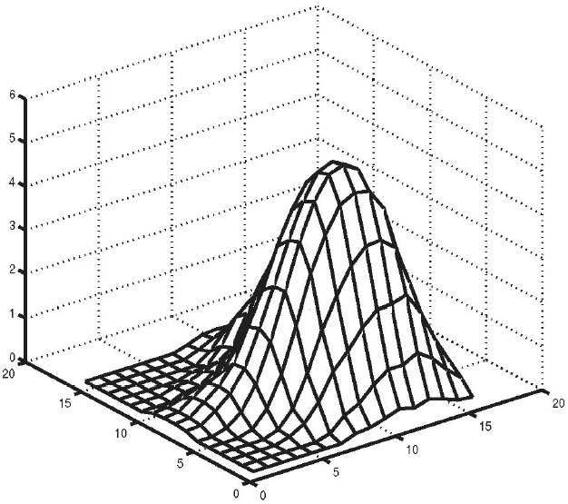
Color indexing
We quantized the (r, g) space into a number of discrete cells.
A histogram (H₁) was then defined for an image such that H₁(i, j) contained the number of pixels in the image whose chromaticities fell in the (i, j)^{th} cell of (r, g) space.
discrete cells
H₁

Slide 3
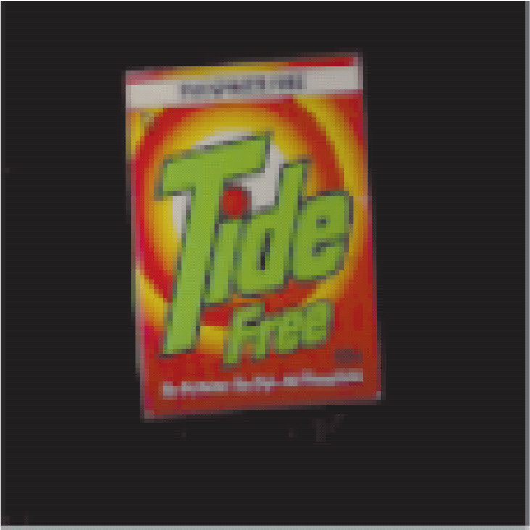
experimental procedure I
test image input
color
constancy
test algorithms
calculate
chromaticity

Slide 4
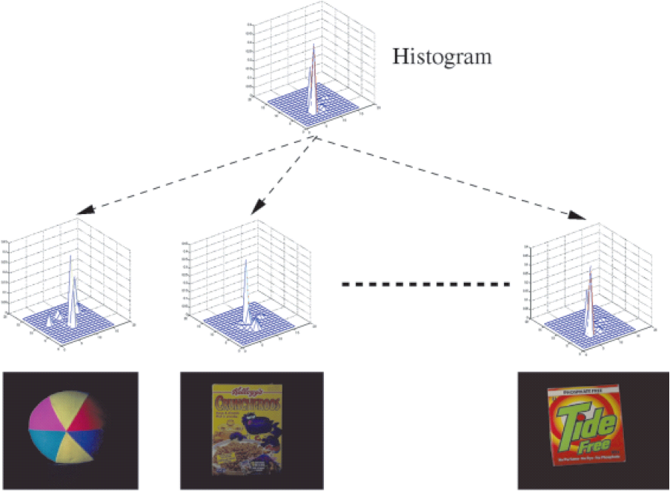
experimental procedure II
False
False
True

Slide 5
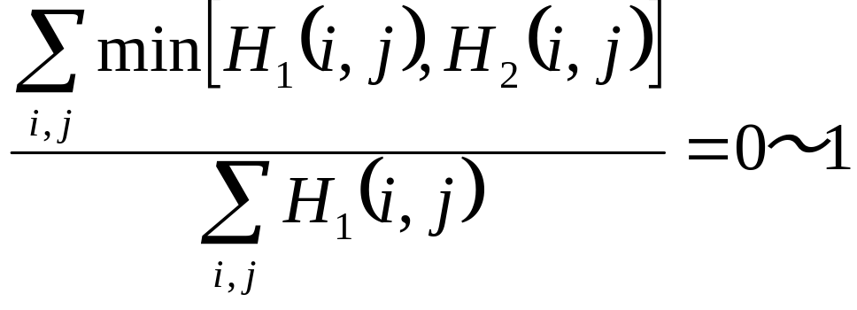
How to identify an unknown object?
intersection method
Histograms for a large number of model images were pre-computed and stored in a database.
This histogram was then compared with each of the histograms in the database to derive a measure of the similarity of the database and the test objects.
The similarity of histograms was measured using the intersection method. Given two histograms (H1 and H2).
intersection method value of 1 implies that the histograms intersect exactly while a 0 value means the histograms don’t intersect at all.

Slide 6
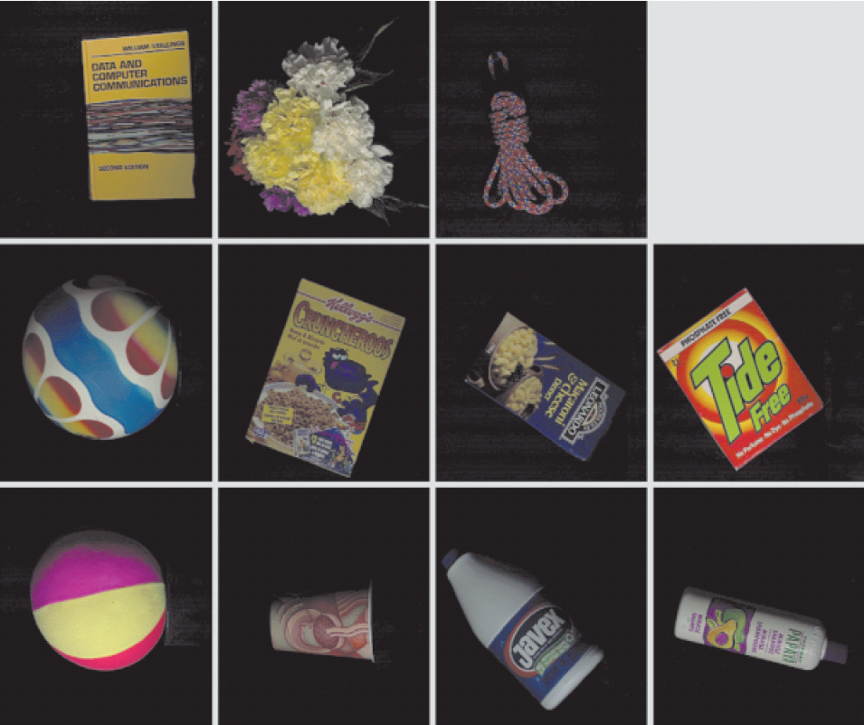
The 11 objects used in the experiment imaged under the Philips Ultralume light.
All images were taken with a Sony DXC-930 3 CCD color video camera
Gamma Correction : OFF
Color Temperature : 3200K

Slide 7
Image Database Contents
Object Name | Description
ball1 | Fuzzy fluorescent ball.
ball2 | Shiny multicoloured ball.
book | Yellow "Data Communications" textbook.
coffee | Disposable coffee cup.
cruncheroos | Cereal box.
flowers | Boquet of carnations.
javex | Plastic bleach bottle.
macaroni | Macaroni & Cheese box.
rope | Multicoloured climbing rope.
shampoo | Plastic shampoo bottle.
tide | Detergent box.

Slide 8
Illuminants
Illuminant Name | Description
mb-5000 | Macbeth 5000 K fluorescent tubes.
mb-5000+3202 | Macbeth 5000 tubes with Roscolux #3202 Full Blue filter.
syl-cwf | Sylvania Cool White Fluorescent tube.
ph-ulm | Phillips Ultralume fluorescent tube.
halogen | Sylvania 75W halogen bulb.

Slide 9
Reference
http://vision.cs.arizona.edu/kobus/research/code/colour_constancy
http://www.cs.sfu.ca/~colour/
Graham D. Finlayson, Steven Hordley, Paul M. Hubel, “Illuminant Estimation for Object Recognition”, Color Research & Application Volume 27, Issue 4 , Pages 260 – 270 Published Online: 17 Jun 2002

